Slide 1
Keyloggers and security
CAPSTONE PROJECT
Presented By :
Lavanya R - Madha Engineering College - BE-CSE

Slide 2
OUTLINE
Problem Statement
Proposed System/Solution
System Development Approach
Algorithm & Deployment
Result
Conclusion
Future Scope
References

Slide 3
Problem Statement
In today's digital landscape, ensuring security measures to protect sensitive information is paramount. However, there exists a necessity to understand and mitigate potential threats, such as keylogging, which can compromise data integrity and confidentiality. Thus, it's imperative to explore keylogger implementation and associated security concerns.

Slide 4
Proposed Solution
The construction of our suggested system comprises the use of Python's Tkinter library for the GUI and the pynput package for keyboard input recording, to create a keylogger. Keystrokes are recorded by the keylogger and saved in text and JSON forms for further examination.

Slide 5
System Approach
Technology Used:
Python: To program the features of the keylogger.
Tkinter: For constructing the GUI, or graphical user interface.
Python input: For recording keystrokes.
JSON: A structured format for storing keystroke data.

Slide 6
Algorithm & Deployment
Initialization: Set up the flags and variables that are required.
Managing Events:
on_press(key): Identifies held and pressed keys. on_release(key): Maintains flag state and logs released keys. logging: keystrokes are saved in a text file using the generate_text_log(key) function. Keystrokes are saved in a JSON file using the generate_json_file(keys_used) function. Keylogger Control: start_keylogger(): Starts the process of keylogging. Stop keylogging with stop_keylogger().

Slide 7
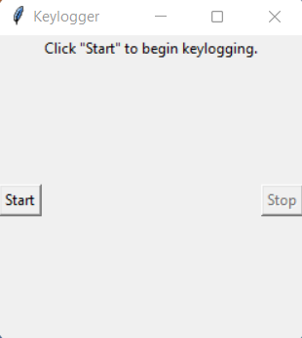
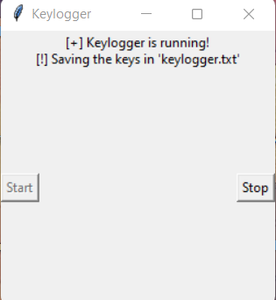
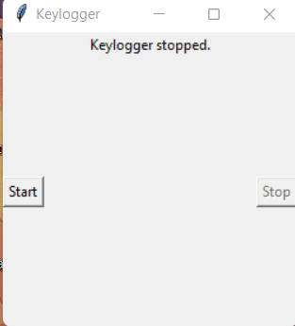
Result
The "Start" and "Stop" buttons on the GUI allow you to manage the keylogging procedure. The keylogger records keystrokes as soon as it starts and stores them in pre-designated files. The logging operation stops when the keylogger is stopped.

Slide 8
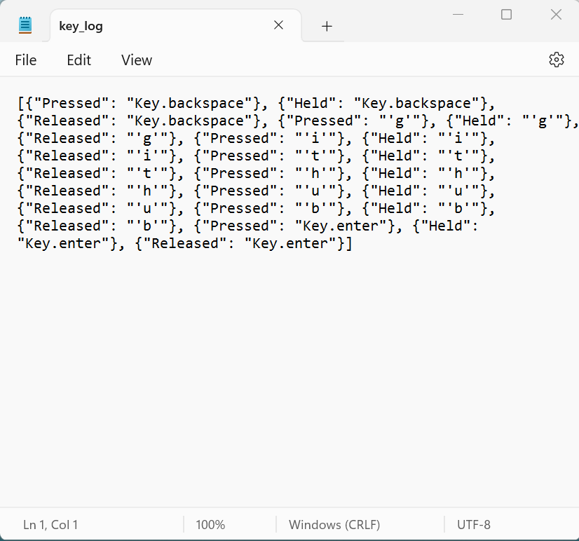
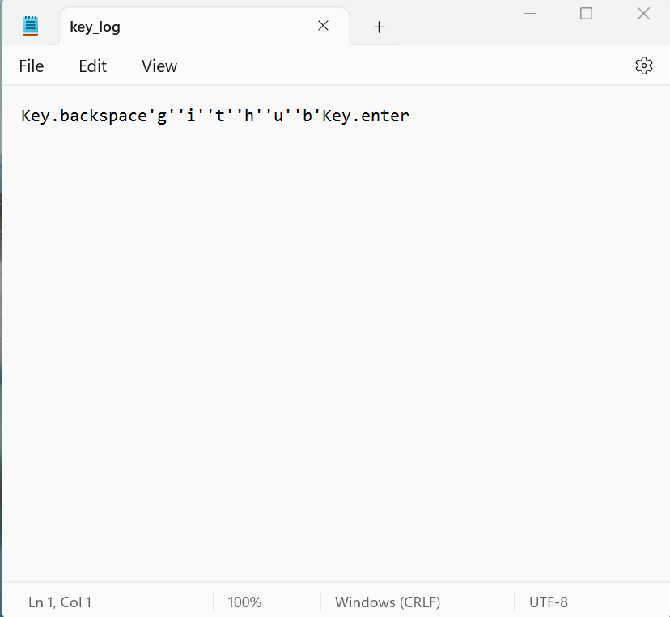
OUTPUT

Slide 9
Conclusion
Using a keylogger demonstrates how simple it is to record keyboard inputs and emphasizes how crucial strong security measures are to preventing unwanted access to private data. Gaining knowledge about keylogging techniques helps protect systems from possible attacks.

Slide 10
Future scope
Improving Security Measures: To secure logged data, use encryption techniques.
User Authentication: To avoid unwanted access, incorporate user authentication methods.
sophisticated Logging: Use features like window tracking and timestamping for sophisticated logging.

Slide 11
References
A Survey on Keylogger and its Detection Techniques by Vishal Bharti, Aditya Kumar Gupta, and Shailendra Mishra https://www.ijcaonline.org/archives/volume75/number5/12835-1514
Analysis of Keylogger Attacks and Countermeasures by Hongliang Liu, Ruiying Du, and Quansheng Zhuang https://www.semanticscholar.org/paper/Analysis-of-Keylogger-Attacks-and-Countermeasures-Liu-Du/54c7255bace229c82e4a5fd812ba8dd8829180c1
Detection of Keyloggers: A Review by Shukor Abd Razak, Ku Ruhana Ku-Mahamud, and Ramlan Mahmod https://www.researchgate.net/publication/220955239_Detection_of_Keyloggers_A_Review
A Comprehensive Study on Keylogger Attack and Defense by Shuo Chen, Rui Wang, XiaoFeng Wang, and Kehuan Zhang https://www.usenix.org/legacy/events/sec11/tech/full_papers/Chen.pdf

Slide 12
THANK YOU

